Slide 1
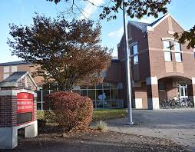
Wilbur Cross High School
Orientation 2023-2024

Slide 2
#CROSSPRIDE

Slide 4
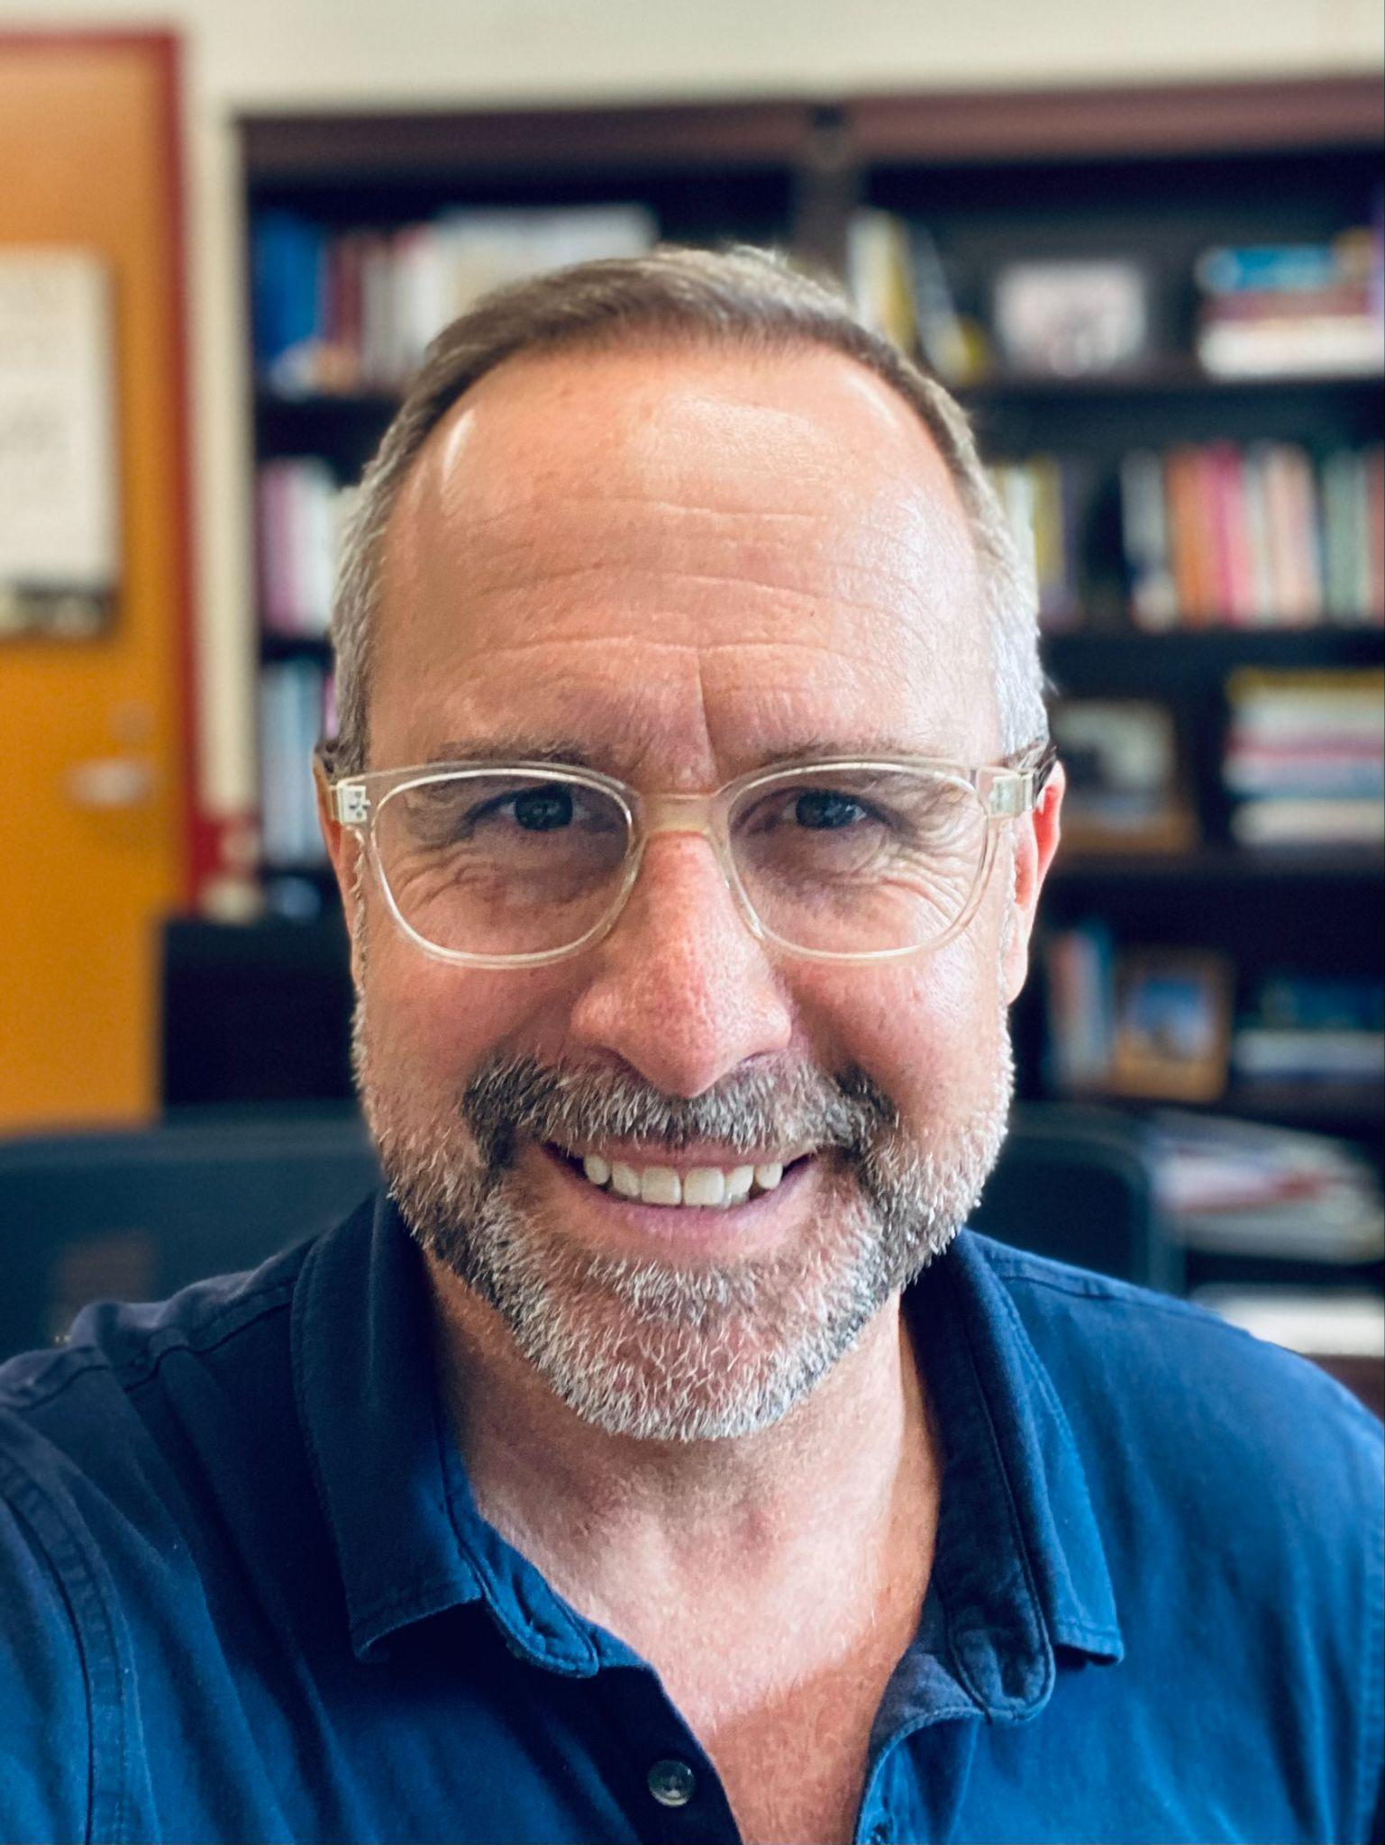
Meet the Administrative Team!
Mr. Matt Brown
Principal

Slide 5
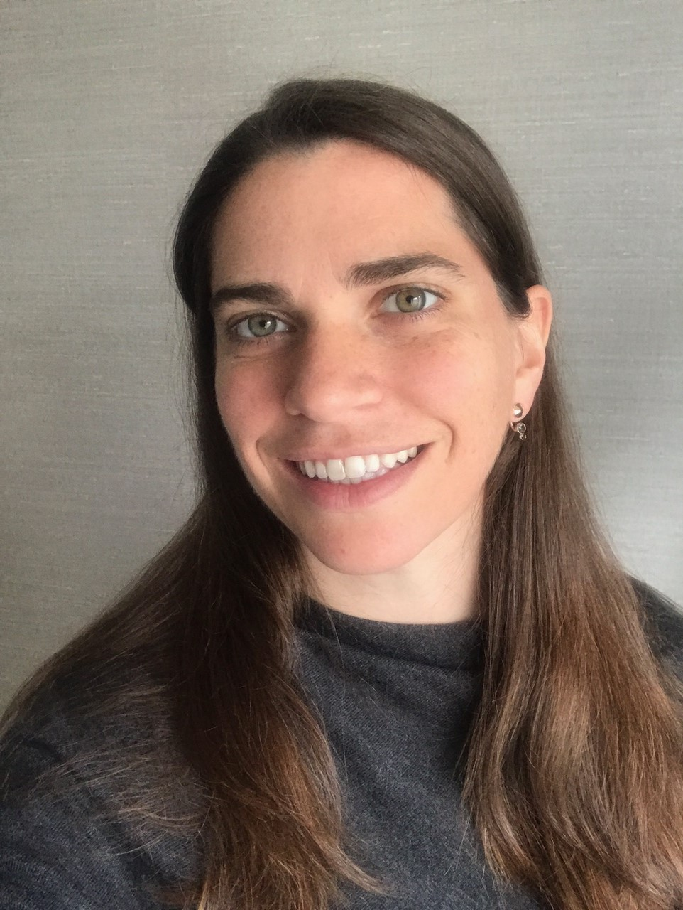
Meet the Administrative Team!
Ms. Ann Brillante
Assistant Principal
Administrator for Special Education Programming (Resource, Life Skills & Multiple Disabled) and Social Studies Department

Slide 6
Law and Public Service Academy
Mrs. Angela Brunson
Assistant Principal
LPS Academy Lead Teacher: Aparna Shyam

Slide 7
International Academy of Digital Arts
and Sciences
Mrs. Cora Muñoz Assistant Principal
IADAS Academy Lead Teacher: Kristin Mendoza

Slide 8
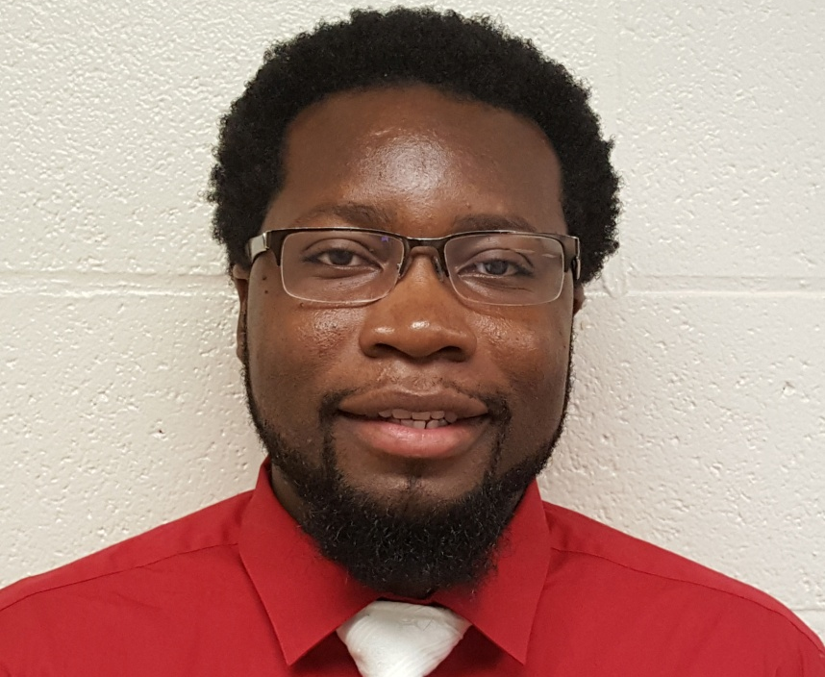
Health and Culinary Sciences Academy
Mr. Garfield Pilliner
Assistant Principal
Academy Lead Teacher: Lisa Chester

Slide 9
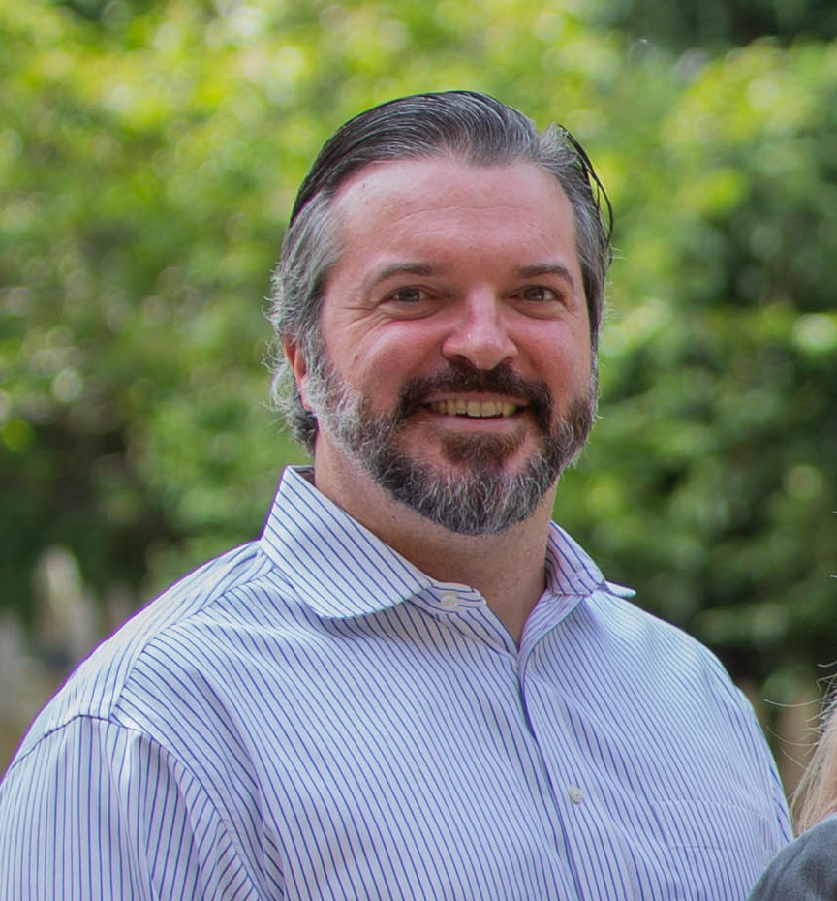
Business and Fine Arts Academy
Mr. Daniel Wajnowski
Assistant Principal
Academy Lead Teacher: Cathy Ramin

Slide 10
Today you will learn about...
Academic Expectations
Requirements to reach the next grade level and and graduate on time:
Classes
Credits
Attendance
What your transcript represents
How behavior impacts success
How attendance impacts success

Slide 11
Parent Teacher Student Organization (PTSO)

Slide 12
Academic Expectations
Be present and on time, be it your classes in the school building or the online classroom
Be prepared with your materials, homework and have an open mind
“Learn” is an action verb - Be active! Participate! Engage!
Communicate. Actively engage with your teachers and peers, be responsive through email and Google Classroom
Be respectful of self and others
Strive to BEAT your best
Maintain academic integrity
Maintain AT LEAST a 2.0 GPA
Connect and actively monitor your progress with PowerSchool

Slide 13
Graduation Requirements
26 Credits are required for a Wilbur Cross Diploma. Below are the class requirements for graduation:
Humanities: 9 credits total
English 1, 2, 3 & 4 (4 credits)
World History, US History, Civics (½), Social Studies Elective (½) (3 credits)
Humanities courses, including Fine Arts (2 credits)
STEM: 9 credits total
Algebra 1, Geometry, Algebra 2, Math Elective (4 credits)
PhyChem, Biology, Chemistry (3 credits)
STEM courses (2 credits)
Physical Education: 1 credit
Health: 1 credit
World Language: 2 consecutive credits in 1 language
Capstone: 1 credit
Electives: 3 credits
For the Class of 2026 and beyond, 50 hours of community service will be required in addition to the 26 credits.

Slide 14
Grade Level & Credit Requirements
You need the following number of credits to move on from each grade level:
9th to 10th → 7 credits + 15 hours of community Service
10th to 11th → 14 credits + 15 hours of community Service
11th to 12th → 20 credits +10 hours of community
12th to Graduation → 26 credits + 10 hours of community
Remember: 40 hours of approved community service is required for New Haven Promise scholarships.
The Class of 2026 will be required to complete 50 hours of community service.

Slide 15
Freshman Year (9th Grade)
You will have more independence & responsibility for your learning
Time management is important everyday, every period
This is the year to be serious and start strong
You need to earn 7 credits to move to tenth grade
Work on building and keeping routines at home and in school that promotes success
Use and review powerschool regularly.
Be mindful of the information collected on your transcript (attendance, grades, exam grades, GPA)
Ask for help and guidance from trusted adults
Build positive relationships and get connected to the Cross Community

Slide 16
Sophomore Year (10th Grade)
Continue to work hard in your classes and improve your grade point average
Continue to seek guidance from trusted adults and older students
Choices …Keep your goals in mind. Post high school planning begins now!!!!! Opportunity abounds…
Review powerschool regularly (attendance, courses, grades).
Review your transcript at the end of the year
You need to earn 14 credits to move on to 11th grade
Plan for what you want to do after graduation

Slide 17
Junior Year (11th Grade)
Last year to raise your GPA for college.
Is there at least 1 AP or ECE course in your schedule?
Investigate Post Secondary options
Begin planning for senior year:
Review transcript with counselor
Update Naviance Account
Take PSAT & SAT
PSAT/National Merit Scholarship
Seal of Biliteracy
ASVAB
Request letters of recommendations from teachers
Must earn 20 credits to move on to 12th grade
Make sure you have your College Board Account
PSAT Testing (Fall) | SAT Testing (Spring) | NGSS Testing (Spring) Seal of Biliteracy Testing (Spring)
Review powerschool regularly.
Review your transcript at the end of the year.
Notes:
ECE and AP Courses are for ALL PEOPLE College Going. AP - ALL PEOPLE. ALL Colleges (community, state, private, prestigious — ALL Colleges). The district goal is for all college going juniors and seniors to graduate having taken at least one college level course. ECE and AP Courses are college level courses. We prioritize them in the schedule based on the requests of juniors and seniors. So if you are a college going Junior or Senior, take course selection seriously. Look at your schedule now and request changes during add/drop. AP is for ALL PEOPLE College going.

Slide 18
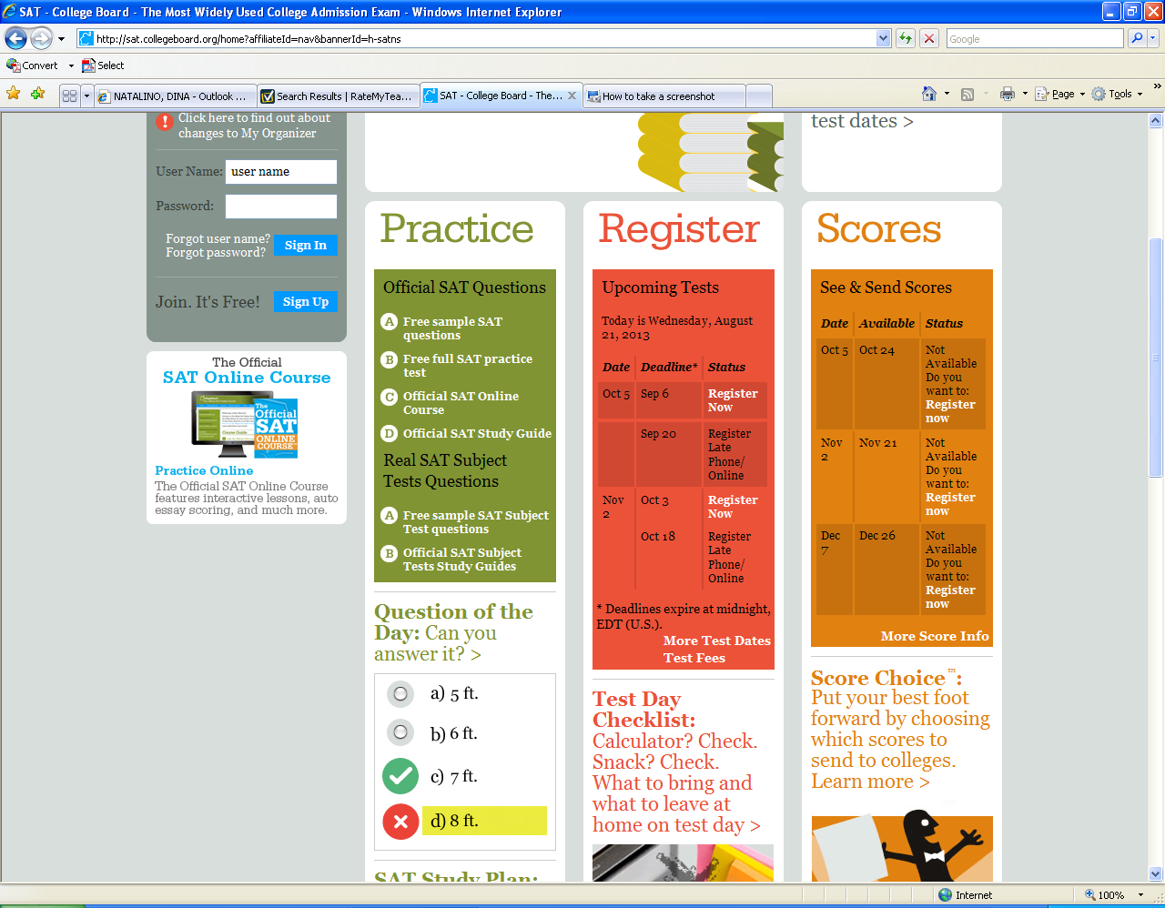
College Board Account
Relevant for: Juniors taking SATs and students taking AP exams.

Slide 19
Senior Year (12th Grade)
Senior Year Plan:
School Counselor
Necessary classes
Credit retrieval if needed
Pass your classes! You need 26 credits to graduate!
Get involved
Senior Activities (Prom, Trip, etc.)
Capstone is required
40 hours of community service are needed to qualify for the New Haven Promise.
Postsecondary Plan:
Create it!
College (2 or 4 year)
Military
Trade School
Apprenticeship
Workforce

Slide 20
Senior Year (12th Grade)
Certification Opportunities at your fingertips:
EMT: Yale NEW HAVEN HEALTH
Modified schedule
Paid Internship
Access to Paramedic Program
State testing Preparation

Slide 21
Senior Year (12th Grade)
Certification Opportunities at your fingertips:
CNA: EXCEL ACADEMY
Certified Nursing Instructor
Modified Schedule
State testing Preparation
Access to 1-yr paid PCA internship at YNHH

Slide 22
Student Led Conferences
At Wilbur Cross we hold Student Led Conferences (SLCs)
Instead of the traditional Parent-Teacher Conferences. Student Led Conferences differ in two key ways:
Students prepare and lead the conference
Conferences take place at Progress Report time so that students have the opportunity to course correct
During SLCs, the student should talk about the following with teacher support:
Academic successes and areas of improvement
Social Emotional success and areas of improvement
Next steps they will take to leverage successes and address areas of improvement

Slide 23
Student Led Conferences
Student Led Conferences will be held on the dates below. Wilbur Cross will dismiss at 11:00a.m. for each of the dates below so that there is ample time to accommodate scheduling for SLCs.
Homeroom teachers will reach out to you two weeks prior to the SLC date to set up a time.
SLC #1:
SLC #2:
SLC #3:

Slide 24
Stay Connected to Class Happenings!
During the school year we will have…
Student Grade Level Meetings
Specific Class Wide Activities
Specific Academy Wide Activities
Assemblies with Principal and Administration
Juniors and Seniors, make sure you are looking out for…
Info & dates for PSAT, SAT and NGSS
Junior meetings with counselors
Senior meetings for parents and students with School Counselors
Senior Dues
Senior Activities

Slide 25
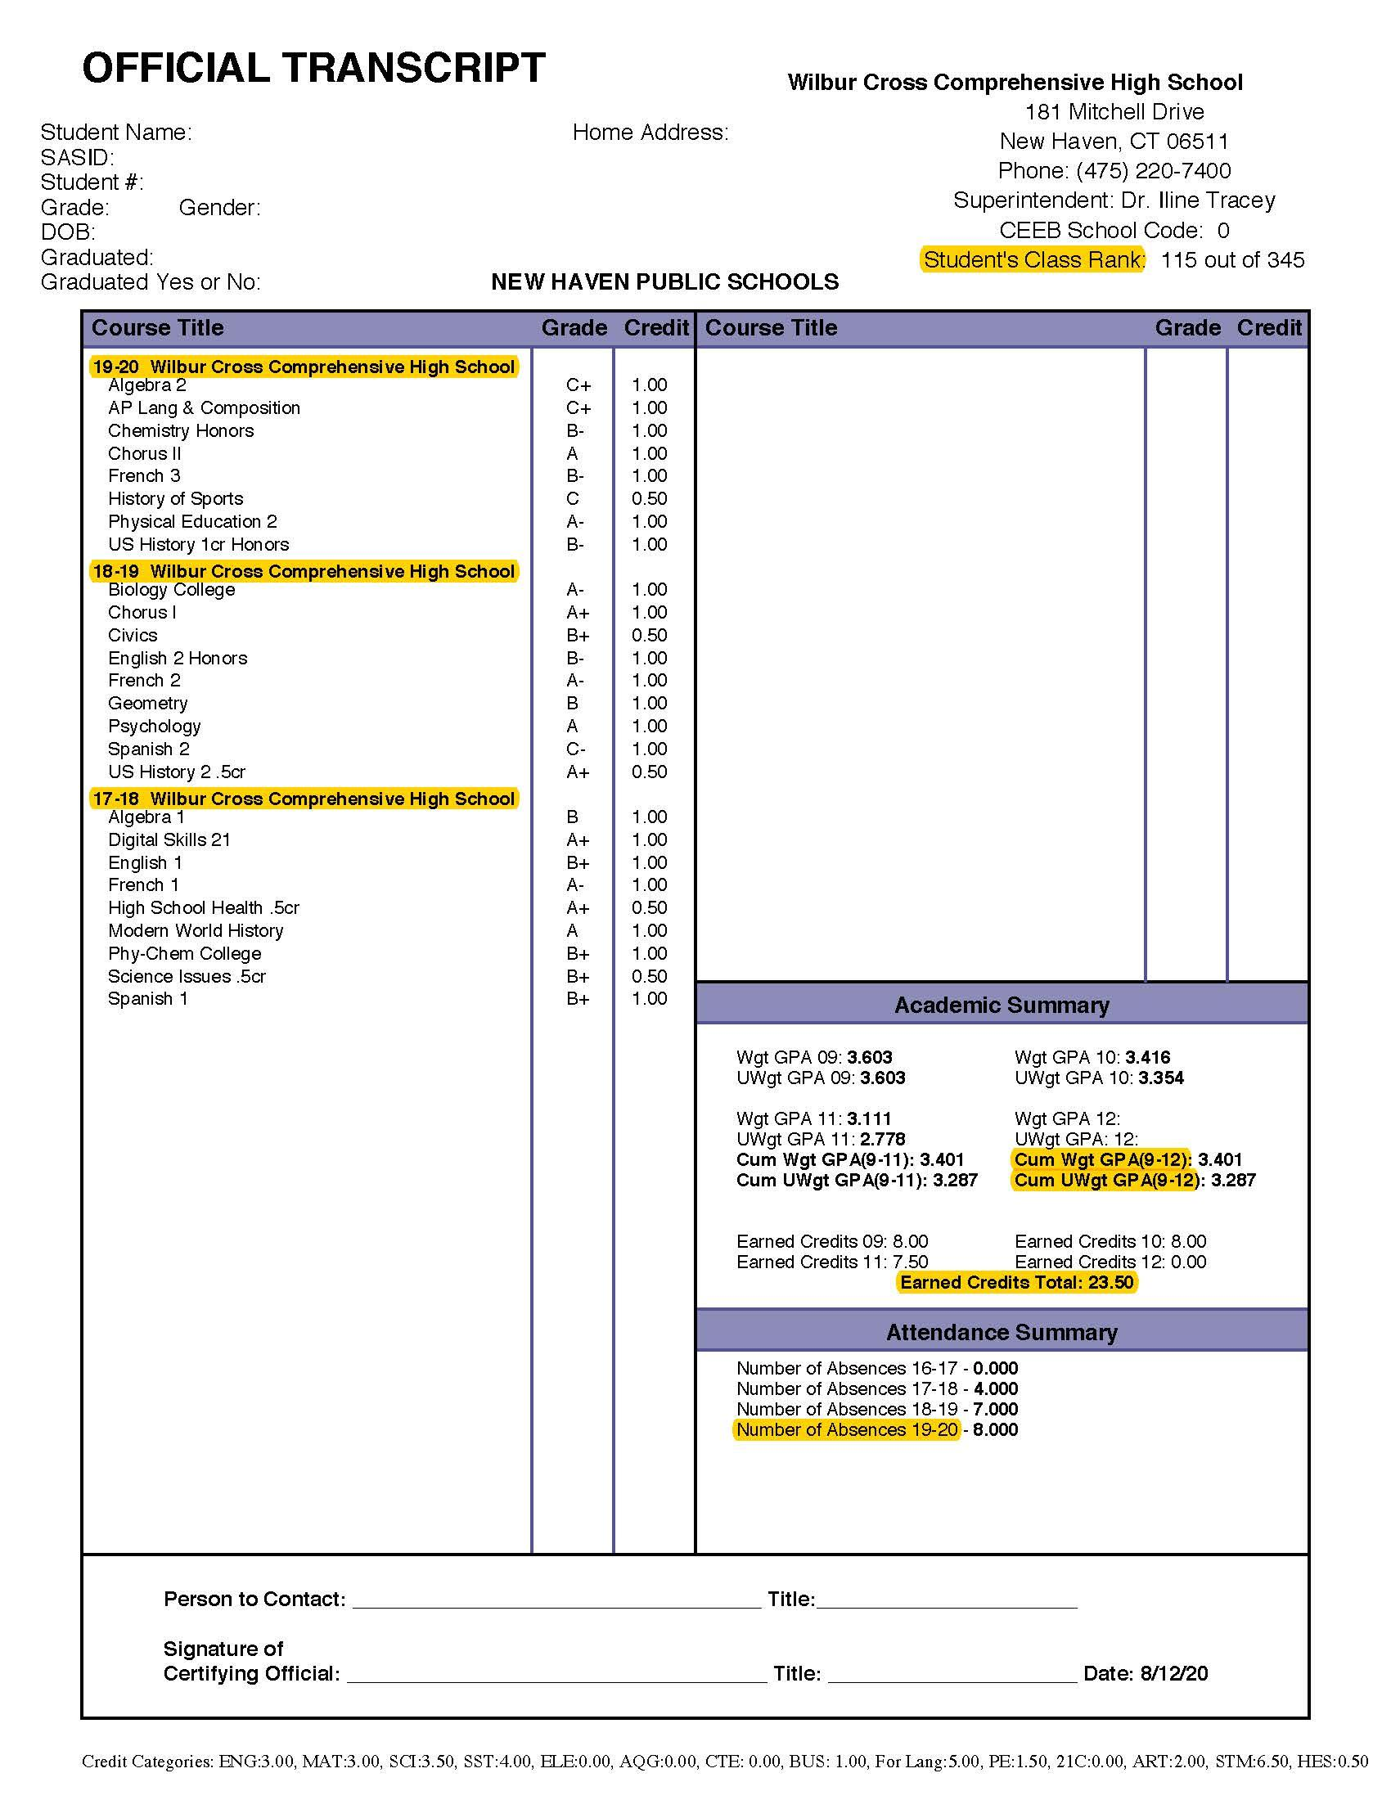
Your School Counselor can review your transcript with you.
Your Official Transcript shows the classes you have taken each year along with your GPA and Attendance for each year you are enrolled.
Information about the current school year is not on the Official Transcript until the close of the school year (or if you need to withdraw from Wilbur Cross).
Notes:
Review transcript

Slide 26
New Haven Scholarships
New Haven Promise
Passport to Promise
Full scholarship to a 2 or 4 year public college or university in CT or up to $2,500 annually for a private nonprofit state college or university for eligible high school graduates.
Requirements
New Haven resident
GPA of 3.0 or higher
A positive disciplinary record
40 hours of community service
90% or better attendance record (no more than 72 absences over 4 years)
20 one-time $1,000 scholarships. Passport recipients who maintain a 2.0 GPA or higher each semester of their freshman year will be eligible for a full New Haven Promise Scholarship in future years.
Requirements
New Haven resident
GPA between 2.5-2.99
A positive disciplinary record
40 hours of community service
90% or better attendance record (no more than 72 absences over 4 years)

Slide 27
PowerSchool Account
PowerSchools is the electronic platform where students and their parents/guardians can find their class schedule, review their assignments for each class, assignment and marking period grades, daily attendance and class attendance. Teachers update grades at least every two weeks in PowerSchool and attendance is maintained throughout the school day each day in PowerSchool.
It is critical that students and their families know their PowerSchool login information starting at the beginning of the year so they can monitor academic progress and attendance throughout the school year.
PowerSchool Accounts are also necessary to fill out the beginning of the year Orientation paperwork online.
At the conclusion of this orientation you will be able to pick up your PowerSchool logins for Parents & Students.

Slide 28
E-Hall Pass
Wilbur Cross is going to use the E-Hall Pass system starting this school year.
It is critical that all students have the E-Hall Pass Application on their phone so they can request passes (for example to the bathroom) and receive appointment requests and passes (for example, an appointment with their school counselor).

Slide 29
Opening of School
August 31, 2023 is the first day of school at Wilbur Cross for all students
New students and 10th graders must submit their CT Health Assessment & Immunizations before the first day of school or you will not be able to attend school.
All students are expected to be in school 5 days a week, should arrive no later than 7:20a.m. each day and end the day at 2:00p.m. each day.
Es responsabilidad de los estudiantes seguir su horario tal como está descrito en PowerSchool en todo momento.

Slide 30
Schedule
Full Day Schedule: Monday, Tuesday, Thursday & Friday
Begins | Ends | Period | Duration | Passing Time
7:30 AM | 8:52 AM | 1 | 82 minutes | 5 min.
8:57 AM | 9:09 AM | HR | 12 minutes | 5 min.
9:14 AM | 10:36 AM | 2 | 82 minutes | 5 min.
10:41 AM - 12:32 |  | Lunch Block (25 min.) / Block 3 (82 min.) |  | 4 min.
12:37 PM | 1:59 PM | 4 | 82 minutes
Lunch Times
Lunch 1 (L1) | 10.41 - 11.06 | This schedule runs every: Monday, Tuesday, Thursday and Friday
Lunch 2 (L2) | 11.24 - 11.49
Lunch 3 (L3) | 12.07 - 12.32

Slide 31
Schedule
Full Day Schedule: Wednesday
Begins | Ends | Period | Duration | Passing Time
7:30 AM | 8:44 AM | 1 | 74 minutes | 5 min.
8:49 AM | 9:34 AM | Extended Homeroom | 45 minutes | 5 min.
9:39 AM | 10:53 AM | 2 | 74 minutes | 5 min.
10:58 AM - 12.42 |  | Lunch Block (25 min.)) / Block 3 (74 min.) |  | 4 min.
12:46 PM | 2:00 PM | 4 | 74 minutes
Lunch Times
Lunch 1 (L1) | 10.58 - 11.27 PM | This schedule runs every Wednesday
Lunch 2 (L2) | 11:41 - 12.06 PM
Lunch 3 (L3) | 12:17 - 12:42PM

Slide 32
Wellness Wednesday
Wellness Wednesday is a Social Emotional & Wellness program that we have grown here at Wilbur Cross. It is an outgrowth of what we have learned during the COVID-19 pandemic and what a group of our Wilbur Cross students developed.
Every Wednesday we will run an extended homeroom schedule. Students will either:
participate in programming (for example: board games, Henna, teacher office hours, social work groups, etc.)
engage in explicit social emotional and wellness lessons with their homeroom teacher
prepare for their SLCs

Slide 33
What To Bring To School
Make sure every day you:
Bring a water bottle (no glass)
Materials needed for your classes that day
Regarding lockers: If you want a locker, see your Academy Administrator for a Locker Assignment

Slide 34
Wilbur Cross & COVID-19
As of July 5, 2022 masks are optional. If you choose to wear a mask it must be a cloth mask or disposable mask. No ski masks, bandanas or other non-standard masks are allowed.
If masks are reinstituted, we expect cooperation to keep the community safe.
If your child is sick they should stay home. The School Nurses will provided guidance if your child is COVID positive or should you have questions in regards to a possible exposure outside of school.
As guidance and protocols evolve and change at the State, City and District level communications will go out to students, family and staff.

Slide 35
School Counselors
Each student at Wilbur Cross is assigned a School Counselor.
School Counselors support students in scheduling classes, understanding where they are in relation to graduation requirements, support social emotional well being, oversee the development and communication of 504 plans and much more.
If a student would like to meet with their School Counselor they must make an appointment through email or calling with the exception being if a student is in crisis or has an emergency and needs to see their counselor.
Any questions regarding courses or credits should be directed to your child’s school counselor.
The window to request to add/drop a class is from now until September 22nd and must be done through the Google Form on our website.

Slide 36
Emergency Contacts & Forms
Please make sure you complete all the required forms, especially the Emergency Contact form. All forms will be completed electronically this year. To fill out forms:
Go to Wilbur Cross website https://www.nhps.net/cross
Click on button for “Orientation Forms”
Electronically complete forms under the welcome letter
Please remember: If you have moved, your home addresses must be changed at the School Choice Enrollment Office downtown. Make sure you have multiple emergency contacts on file with us.
All of this information is critically important and allows for the communication regarding the safety and wellbeing of your child!
You will need your PowerSchool Log in or to create an account to update the information.
Notes:
UPDATE to get emergency cards back. Use powerschool request for schedule

Slide 37
Student Technology
Students who receive devices from NHPS are responsible for maintaining the device in good condition. Laptops must be returned upon graduation or if withdrawing from Cross. Students must follow the Acceptable Use Policy at all times on these devices, at home and at school.
Students using chromebook carts, Mac Labs and other technology in the school must take care of equipment at all times and follow the Acceptable Use Policy.
Students must follow the Acceptable Use Policy (AUP) outlined by the District and Wilbur Cross. The AUP can be found in the Student & Family Handbook.
Wilbur Cross is not responsible or liable for students’ technology or cellphones.

Slide 38
Safe School Policy
The Safe School Policy for Wilbur Cross is on the school website and includes the Code of Conduct, Discipline and Student & Family Handbook.
The Safe School Policy outlines important school and district rules. Take time to read through the Safe School Policy. You should keep it to reference throughout the school year.
The Safe School Policy contains information on:
Student Rights and Responsibilities
Expectations for students, parents, teachers, administrators and schools
List of major and minor offenses and corresponding consequences

Slide 39
Behavioral Expectations
RESPECT yourself and others
Maintain maturity, integrity and character
Follow your schedule. Be in your class. Not in the halls during class time. Hall sweeps happen here.
Be honest - it’s a chance to explain your thinking and think through choices.
Opening doors-help keep us safe!
Uber Eats and Other Deliveries are not allowed and will be confiscated if found
Bullying and/or harassment will not be tolerated
Find an adult to talk to if you are having trouble
If you choose to fight, you choose 9 days suspension!
For more detailed information, please refer to the Wilbur Cross Student & Family Handbook.

Slide 40
Reminders …
Our code of conduct has specific consequences for behavior that influences the safety of the community
Substances
Authorized entry doors
Opening doors for students or propping doors open
Weapons
Confronting students without adult help
Social Media
Filming

Slide 41
Daily Attendance
Daily school attendance is important! Attendance is ultimately the responsibility of the student and their parent(s)/guardian(s).
Students who have 4 unexcused absences in any given month or have 10 or more unexcused absences are considered truant and the Academy Attendance Team will refer the student to the Truancy Officer in addition to other interventions.
If your child is absent from school due to illness or doctor appointment, please be sure to call or email the Main Office to let us know and turn in any doctor’s notes or documentation in the Main Office or via email.

Slide 42
Class Attendance
Class attendance is critical! Getting to class on time (before the bell rings) and staying in the class the full period is the responsibility of the student.
Class attendance is taken every day for each class. Attendance can be seen on PowerSchool.
Hall Sweeps will be conducted regularly. Students have 5 minutes of transition time between each class. After the bell rings if students are still in the hallway and a Hall Sweep will be conducted. If students accumulate more than 3 Hall Sweeps consequences, including suspension, may be applied.

Slide 43
Student Support Services
Body Shop
Substance Abuse Intervention
College & Career Center
Day Care Center
Excel Academy (CNA)
Reading Intervention
SROs
Truancy Officers
Student Intervention Programs
Community Mediation
Visual/Speech Pathologist
Psychologists, Social Workers and Social Work Interns
Nursing Services
Independent Studies Seminar
Tutorial Services

Slide 44
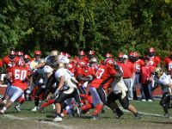
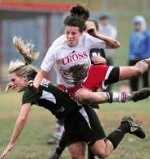
Athletics
2.0 GPA Needed
Fall
Swimming
Cross-Country
Football
Soccer
Volleyball
Cheerleading
Winter
Basketball
Wrestling
Indoor Track
Cheerleading
Spring
Golf
Softball
Baseball
Tennis
Lacrosse
Track
Interested in playing a sport this fall? The fall season starts soon. Don’t miss out! We need YOU!
Go to the Cross website and contact the coaches for more information!

Slide 45
CLUBS & ACTIVITIES
Athletic Teams
Best Buddies
Cheerleading
Chorus
Dance Club
Lights Up Drama Club
ECA
French Honor Society
GSA Club
Italian Honor Society
Jazz Band
Middle East/Central Asia Connect
National Honor Society
Proclamation-School Newspaper
Spanish Honor Society
Student Council
Yearbook Club
….and more!
Wilbur Cross offers a wide variety of activities that ensure the well rounded development of an academic, social and civic minded student body.
Have an idea for a new club or activity? Get a staff to sponsor it and you can launch it!

Slide 46
Transportation
NHPS provides bus transportation for all students living more than two miles from the campus.
You will be receiving cards in the mail with bussing information soon.
If you do not receive a card or have any questions or concerns regarding transportation, please call the Transportation Department: (475) 220-1600

Slide 47
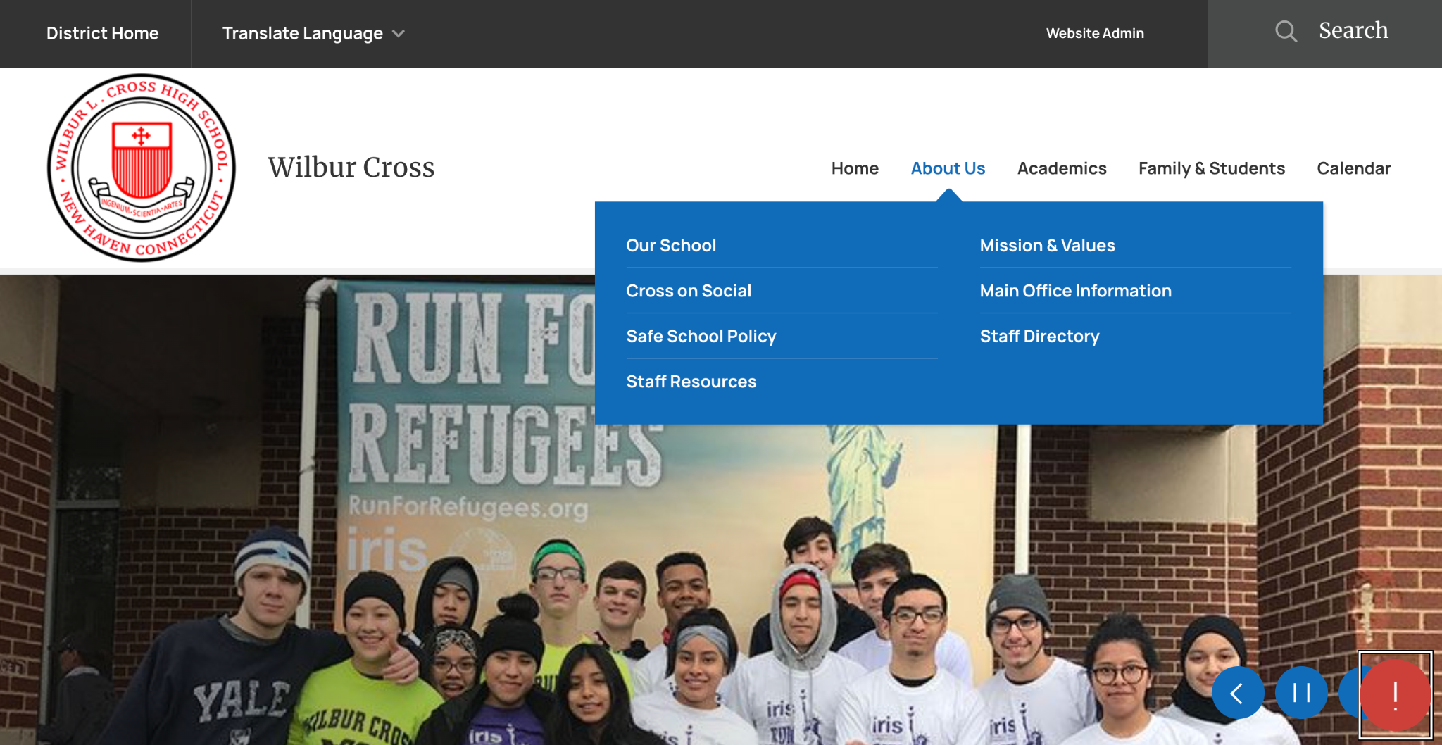
Check out our NEW Website!
We have a new Wilbur Cross Website! Make sure you bookmark the website and take some time to explore. We will be posting all of our announcements, important information, Cross Calendar, alerts, social media and more to the website. If you need a language other than English, there is a translate option on the top left of the page!

Slide 48
Stay Informed!
Parent(s)/Guardian(s) and students, make sure you:
Update your phone number and email by filling out the needed online Orientation Forms
Save our website: nhps.net/cross
Follow us on Instagram @wilbur_cross_hs
Check your @nhps.net gmail at least once a day, every day

Slide 49
Become Part of the Team!
There are many different ways to get involved at Wilbur Cross:
Join the PTSO (first meeting is September 13th!)
Support the many clubs, sports, and enrichment programs running this year
Help us help your children…
Be part of SPMT (the School Planning and Management Team)
Affect decision making
Help create policy
Volunteer one day a month for one hour after school!

Slide 50
To Do After Leaving
Get your PowerSchool access information in the Atrium/Art Wing
Download the PowerSchool App
Go on the Cross Website, click the button for Orientation Forms and use your PowerSchool information to fill out the Emergency Contact information and other important forms
If you are new to the District or a 10th grader: Know how to get information on the CT Health Assessment & Immunizations if you have not yet submitted the information.

Slide 51
Thank you for coming!
#CROSSPRIDE
If you have any questions please reach out to the Principal, Matt Brown, or your child’s Academy Administrator if you have any questions or concerns!
School Phone: (475)220-7400
Email: cross@nhboe.net

